Slide 1
UML Diagrams
Luke, Matt, Jordan, Sam and Joe

Slide 2
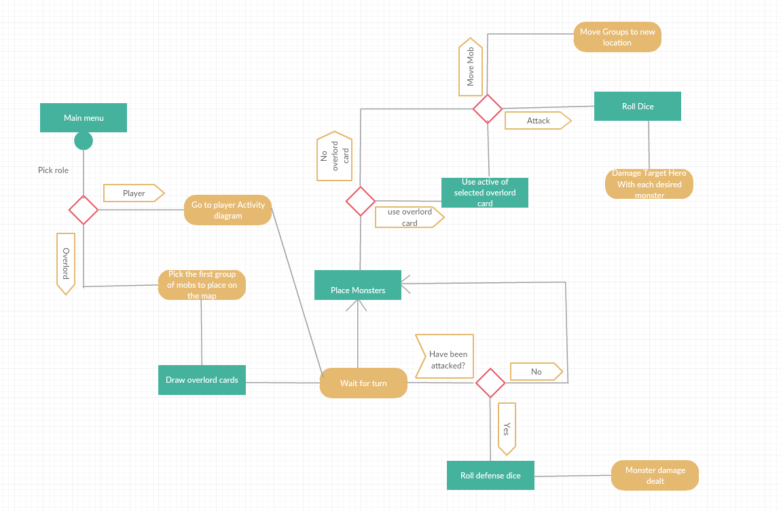
Activity diagram
Overlord
Various overlord steps as to how the overlord’s turn progresses.

Slide 3
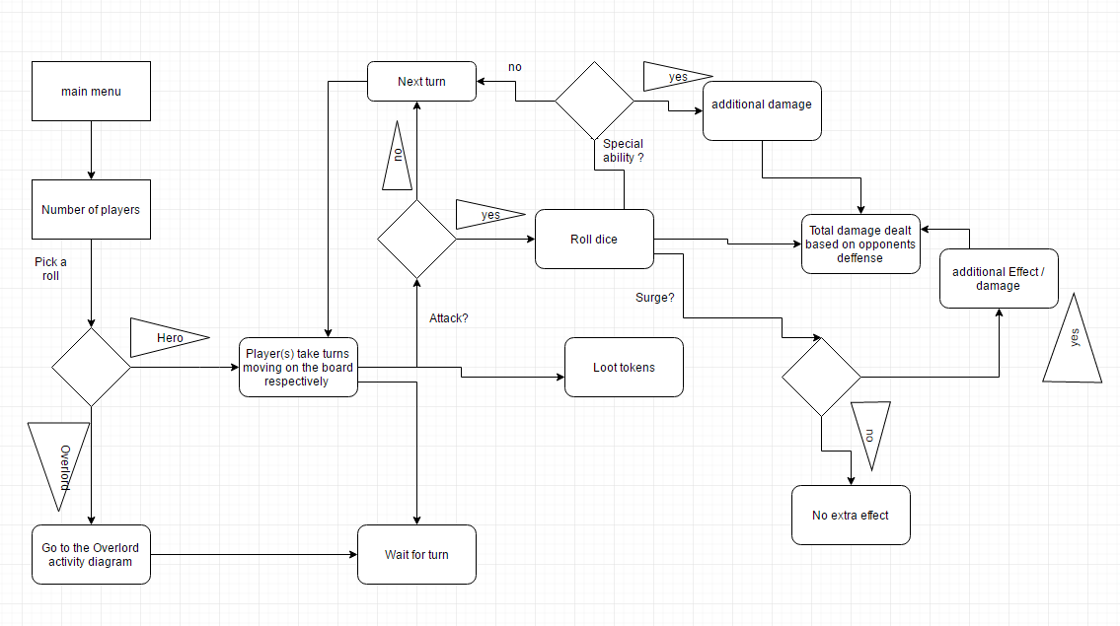
Activity diagram
Hero
Various Hero steps as to how the Hero’s turn progresses. Also how each turn changes the route the player takes in this diagram.

Slide 4
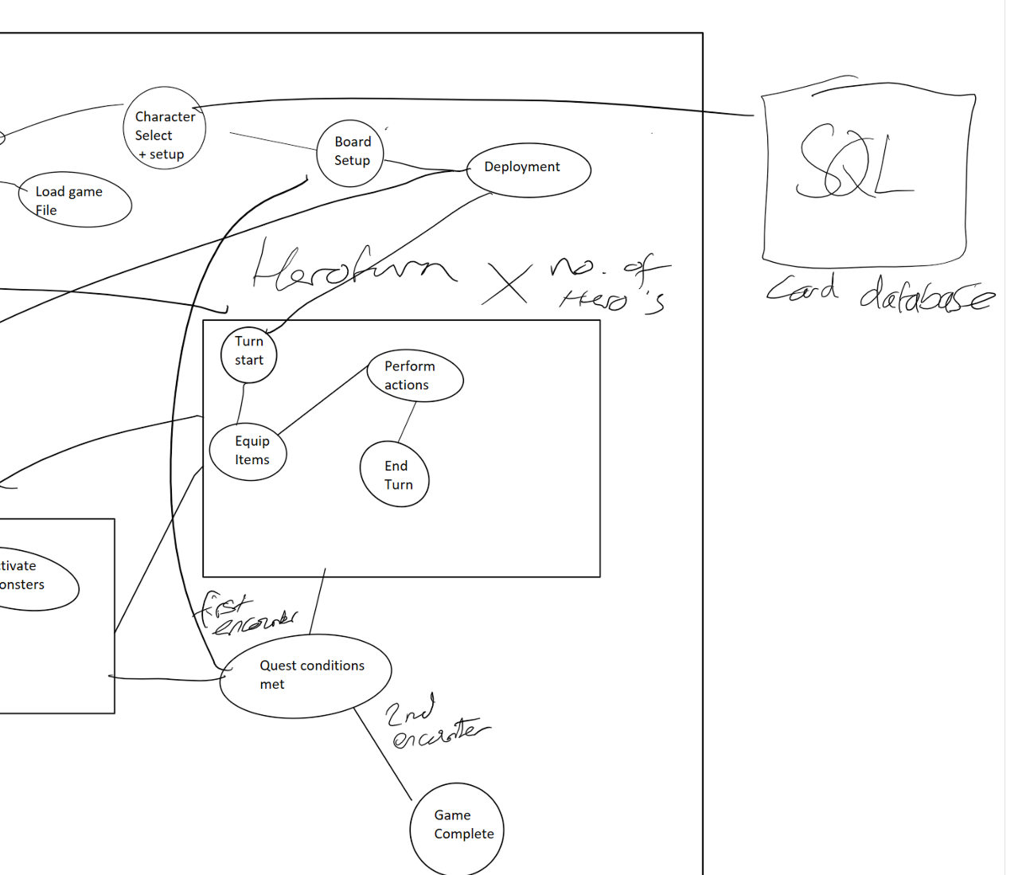
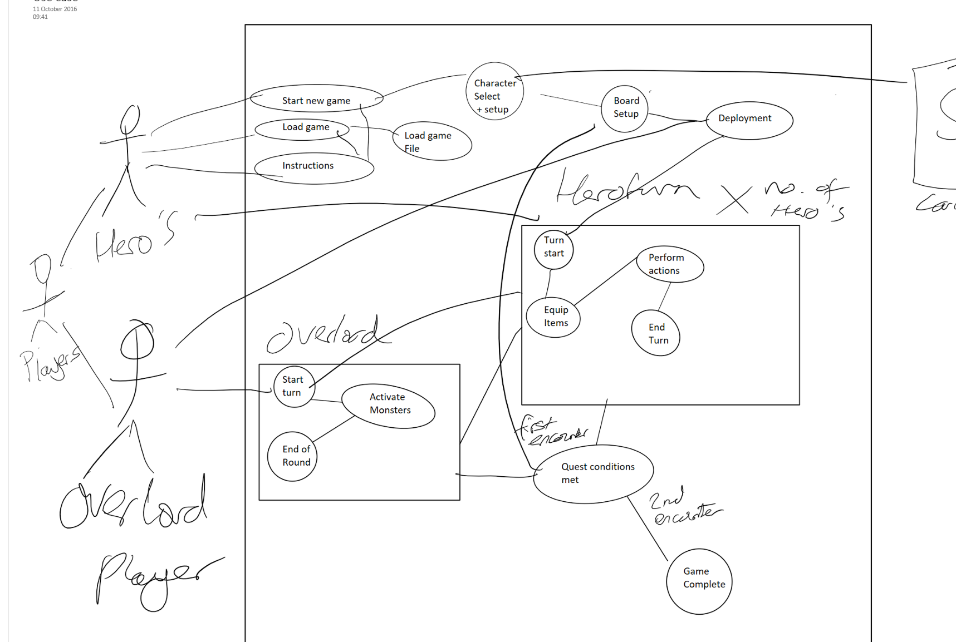
Use Case diagram
The code structure is shown as follows for the entire game including the important SQL database in which the cards will be stored.

Slide 5
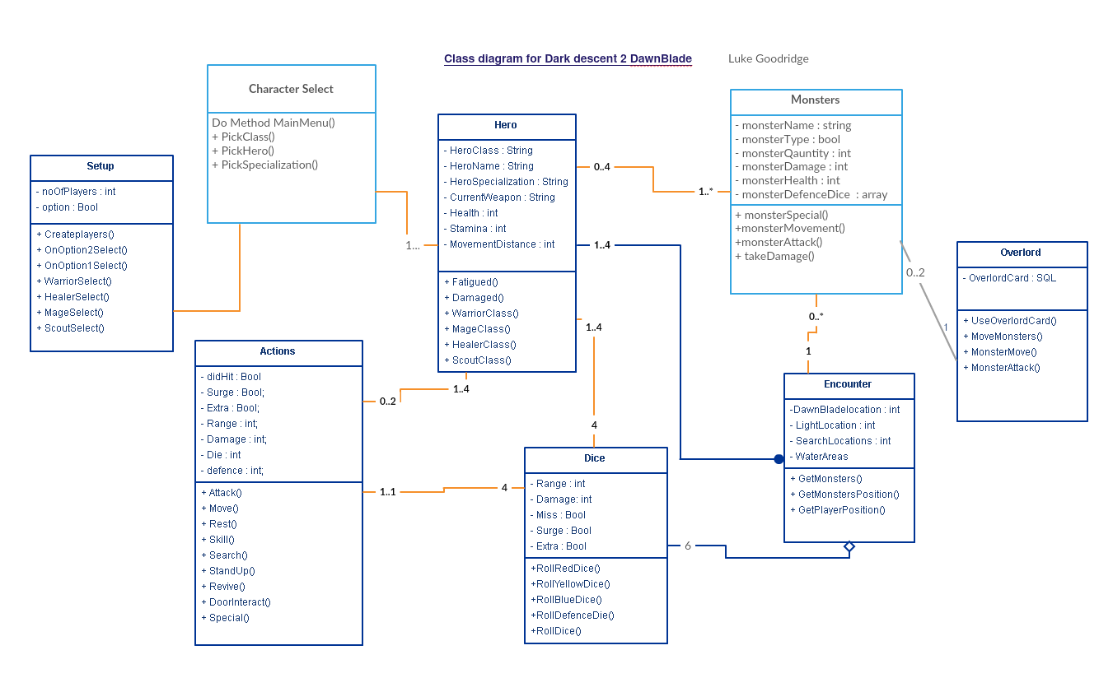
Class Diagram

Slide 6
Thanks for listening!

